Slide 1
Time and Space Complexity
CS201

Slide 2
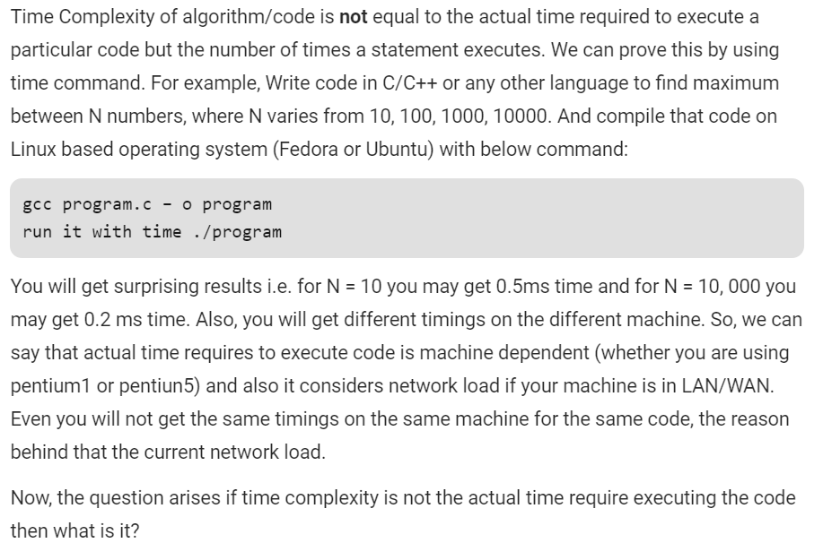
What not!!!

Slide 4
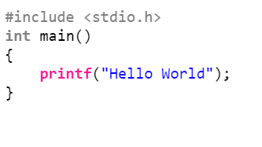
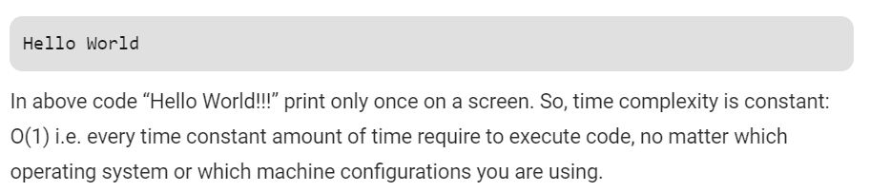
Example1

Slide 5
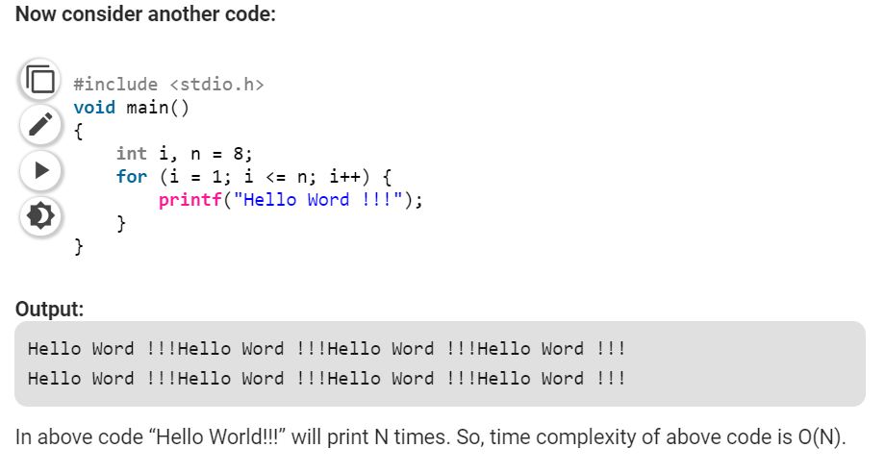
Example 2

Slide 6
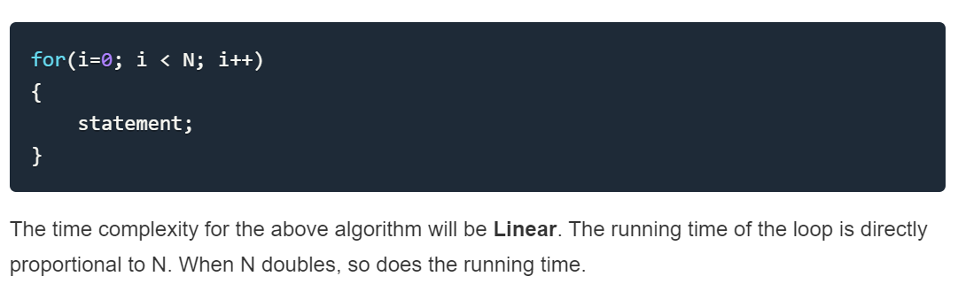
Example 3

Slide 7
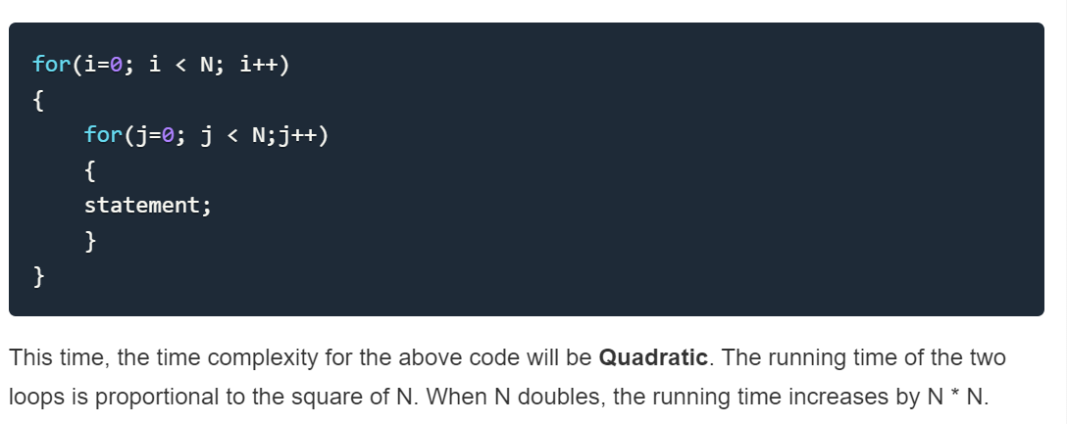
Example 4

Slide 8
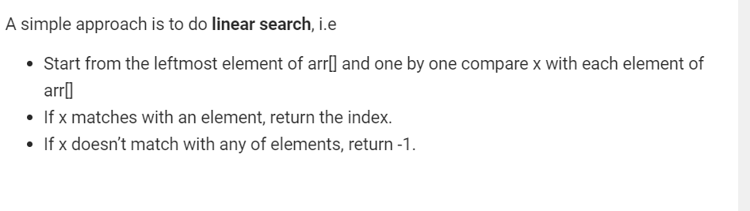
Example 5(Linear Search)

Slide 9
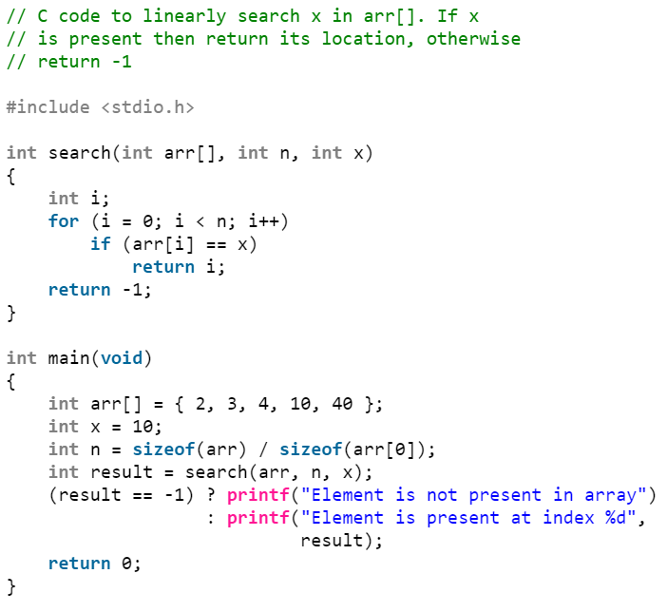
Contd…

Slide 10
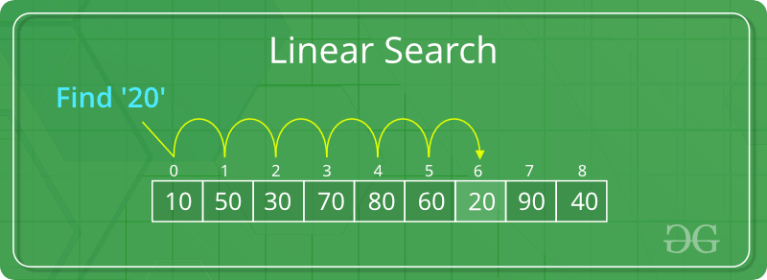
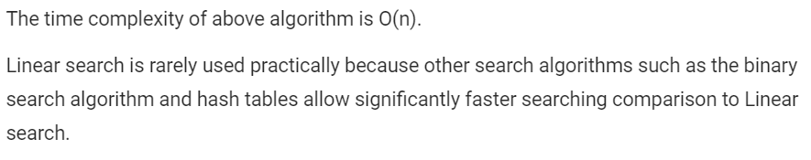
Contd…

Slide 11
Example 6(Binary Search)

Slide 12
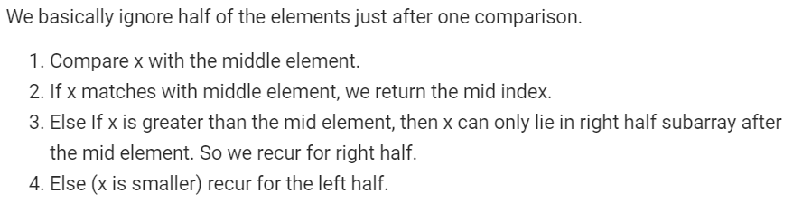
Contd…

Slide 13
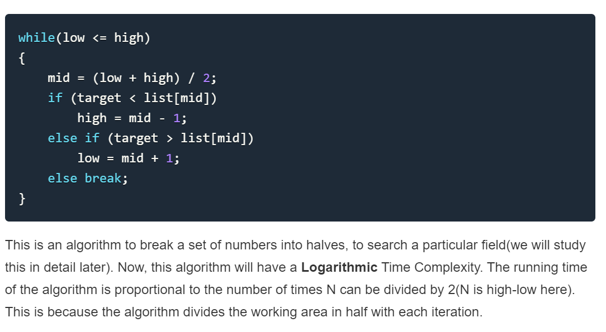
Contd…

Slide 14
Example 7
for (i = 1 to n)
{for j = 1 to n)
{ a[i,j] = i+j;
}}
for (k = 1 to n)
{
b[k] = k;
}
Time complexity = n²+n = O(n²)

Slide 15
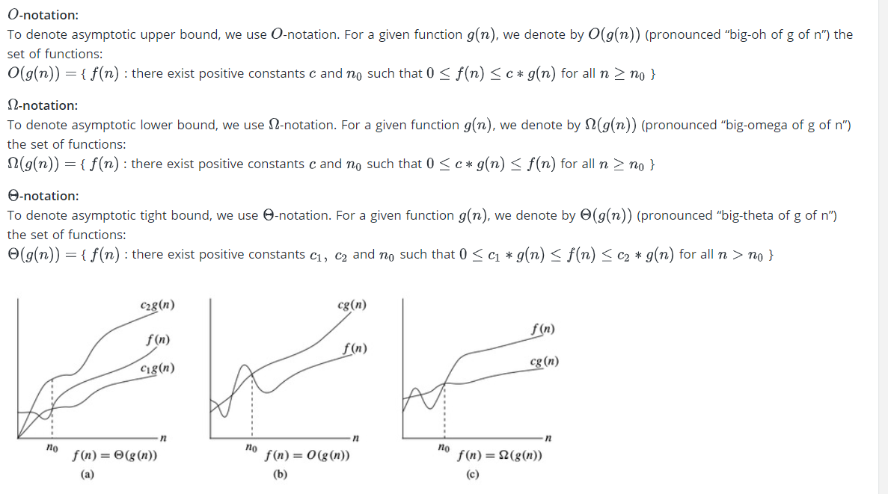
Asymptotic bound

Slide 16
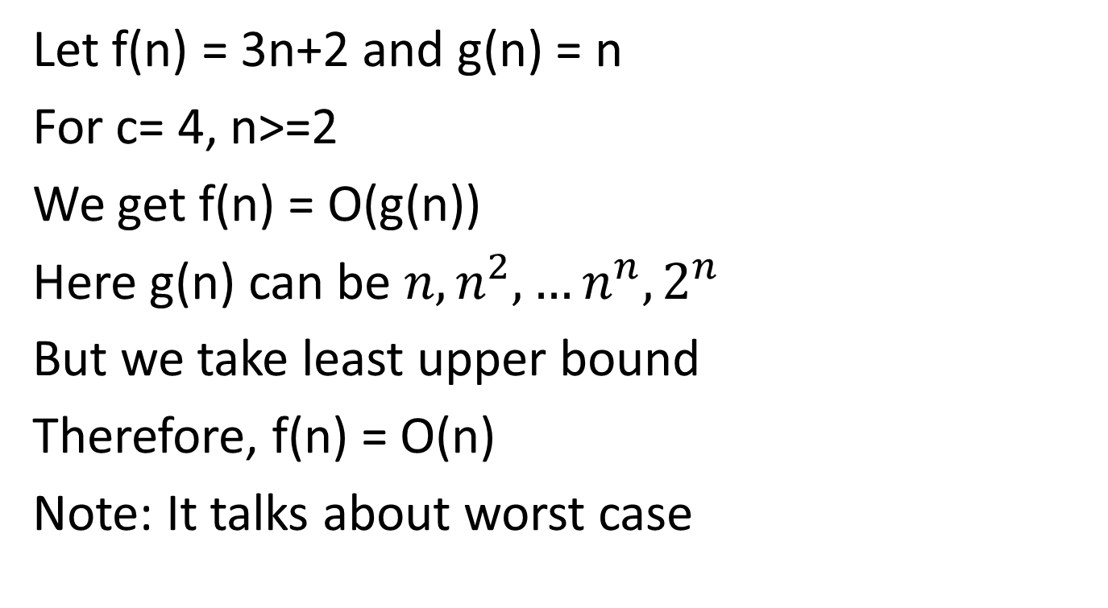
Big O example
Let f(n) = 3n+2 and g(n) = n
For c= 4, n>=2
We get f(n) = O(g(n))
Here g(n) can be $n, n^{2},…n^{n},2^{n}$
But we take least upper bound
Therefore, f(n) = O(n)
Note: It talks about worst case
Solve 3n+2 ≤ cn
n≥ (2/(c-3))

Slide 17
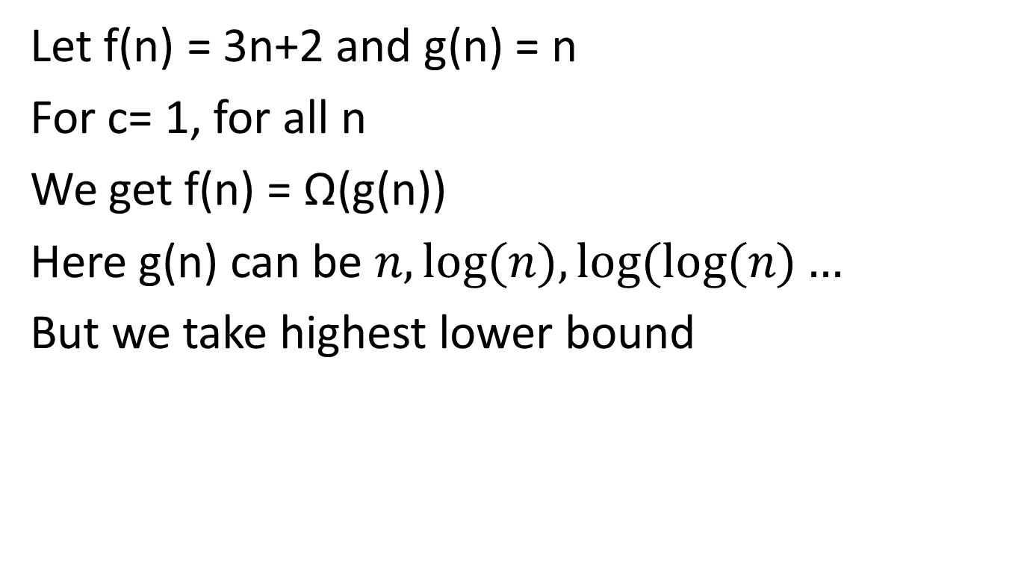
Big Ω example
Let f(n) = 3n+2 and g(n) = n
For c= 1, for all n
We get f(n) = Ω(g(n))
Here g(n) can be $n,log⁡(n),log⁡(log⁡(n)…$
But we take highest lower bound
Solve 3n+2 ≥ cn
Note: It talks about best case

Slide 18
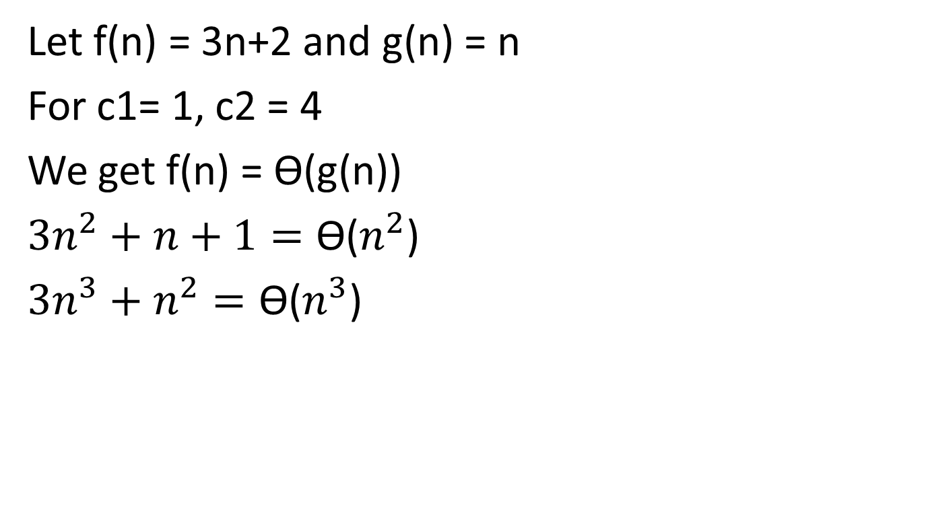
Big Ѳ example
Let f(n) = 3n+2 and g(n) = n
For c1= 1, c2 = 4
We get f(n) = Ѳ(g(n))
$3n^{2}+n+1=\text{Ѳ}$($n^{2}$)
$3n^{3}+n^{2}=\text{Ѳ}$($n^{3}$)
Solve C₁ (n)≤ 3n+2 ≥ C₂ (n)
Note: It talks about average case

Slide 19
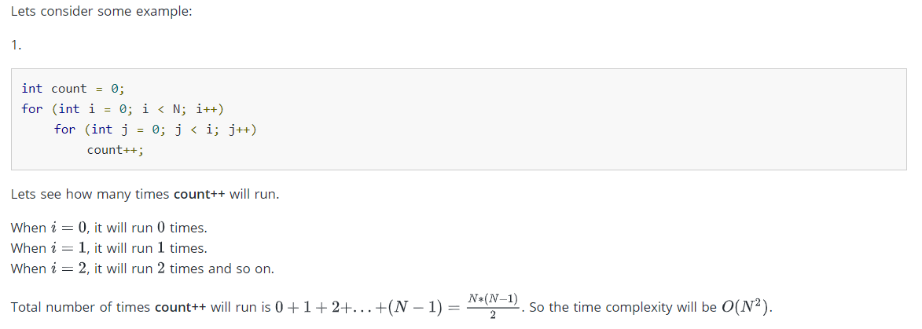
Example on Big O notation

Slide 20
Time Complexity for various operations
Type of Input | Insert | Search | Find min | Delete min
Unsorted Array | O(1) | O(n) | O(n) | O(n)
Sorted Array | O(n) | O(logn) | O(1) | O(n)
Unsorted linked list | O(1) | O(n) | O(n) | O(n)

Slide 21
Array
Array access is O(1) (Random Access is possible)
Array Search is O(n) (Apply linear search)
Deleting an element is O(n) (In delete operation, the element to be deleted is searched using the linear search and then delete operation is performed followed by shifting the elements.)

Slide 22
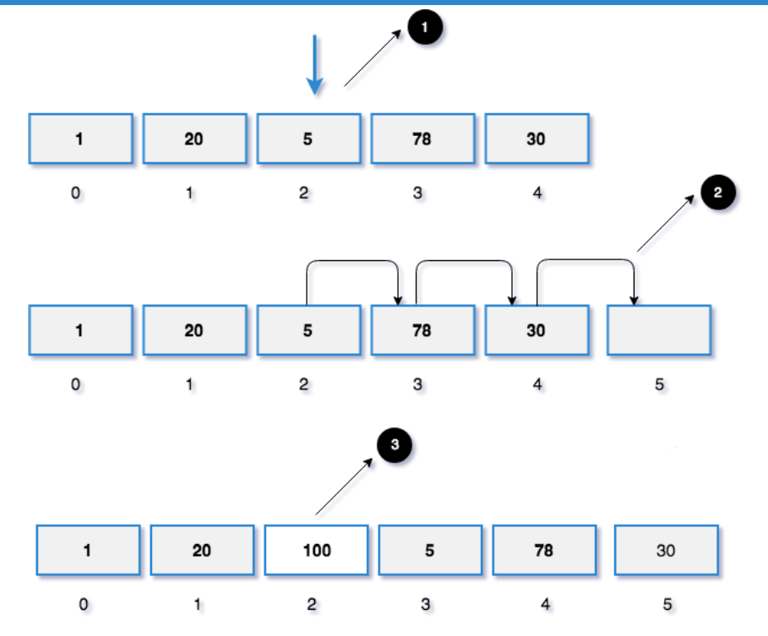
Array insert is O(n)

Slide 23
Contd…
Worst Case - O(N)
If we want to insert an element to index 0, then we need to shift all the elements to right.
For example, if we have 5 elements in the array and need to insert an element in arr[0], we need to shift all those 5 elements one position to the right.
Inserting in an unsorted array: Worst case O(1)

Slide 24
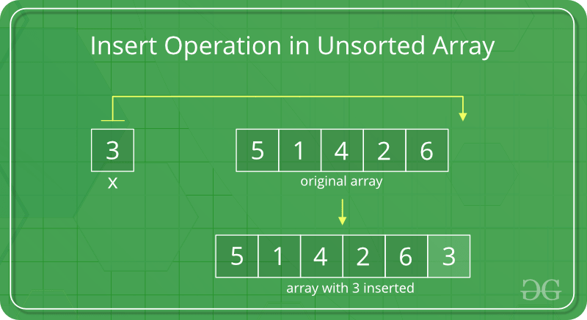
Contd…
In an unsorted array, the insert operation is faster as compared to sorted array because we don’t have to care about the position at which the element is to be placed.

Slide 25
Unsorted Linked List
LL doesn't support random access to its elements by definition.
LL access is O(n)
LL Search is O(n)
Deleting an element is O(n)
Inserting an element is O(1) (we need to just link the new element with the next and previous )
Finding min is O(n)
Delete minimum is O(n+1) = O(n)

Slide 26
Iterative and Recursive Algorithms
Algorithms are of two types: Iterative and Recursive
Note:
1. Any iterative algorithm can be converted into recursive algorithm
2. Any recursive algorithm can be converted into iterative algorithm
3. If there is no iteration or recursion, there is no dependency on input size, then the running time is constant value O(1)

Slide 27
Note on Iterative and Recursion Algorithms
A(n)
{
for i = 1 to n
max(a,b)
}
Equivalent to
A(n)
{
if(...)
A(n/2)
}

Slide 28
For Iterative algorithms
A()
{ int i;
for i = 1 to n
printf(“NIT Goa”)
}
Time complexity O(n)
A()
{ int i;
for i = 1 to n
for j=1 to n
printf(“NIT Goa”)
}
Time complexity O( )

Slide 29
Example
A()
{ int i=1;
int S=1;
While (S<=n)
{ i++;
S=S+i;
printf(“NIT Goa”)
}
}
Time complexity θ( )
i S
1 1
2 3
3 6
. .
. .
. .
k k(k+1)/2
(k(k+1)/2) > n Therefore k =

Slide 30
For Recursive algorithms
Recursion example
star(n)
{
if(n>1)
return star(n-1)
}
Recurrence relation example
T(n) = 1+T(n-1) for n>1
= 1 for n =1;

Slide 31
How to solve T(n)?
1. Back Substitution
2. Recursion tree method
3. Master's Theorem

Slide 32
Back Substitution
T(n) = 1+T(n-1) for n>1
= 1 for n =1;
T(n-1) = 1+T(n-2)
T(n-2) = 1+T(n-3)
Therefore T(n) = 3+T(n-3)
=k+T(n-k)
so it goes till n-k = 1;
Therefore T(n) = n-1 +T(1)= n
Therefore T(n) = O(n)

Slide 33
Recursion tree method
T(n) = 2T(n/2)+c ; n>1
= c ; n=1
C
C
C
C
2C
C
C
C
4C
C
T(1)
T(1)
T(1)
T(1)
2^{k} c
Total workdone: c+2c+4c....nc = T(n)
c(2^{k+1}-1)= T(n)
c(2n-1)= T(n)
Therefore T(n) = O(n)

Slide 34
Master's Theorem
T(n) = aT(n/b) + f(n),
where,
n = size of input
a = number of subproblems in the recursion
n/b = size of each subproblem. All subproblems are assumed to have the same size.
f(n) = cost of the work done outside the recursive call, which includes the cost of dividing the problem and cost of merging the solutions
Here, a ≥ 1 and b > 1 are constants, and f(n) is an asymptotically positive function.

Slide 35
Contd...
An asymptotically positive function means that for a sufficiently large value of n, we have f(n) > 0.
Master theorem is used in calculating the time complexity of recurrence relations (divide and conquer algorithms) in a simple and quick way.

Slide 39
The master theorem cannot be used if:
1. T(n) is not monotone. eg. T(n) = sin n
2. f(n) is not a polynomial. eg. f(n) = 2^{n}
3. a is not a constant. eg. a = 2n
4. a < 1

Slide 40
Master's Theorem for divide and conquer

Slide 41
Contd...

Slide 42
Contd...

Slide 43
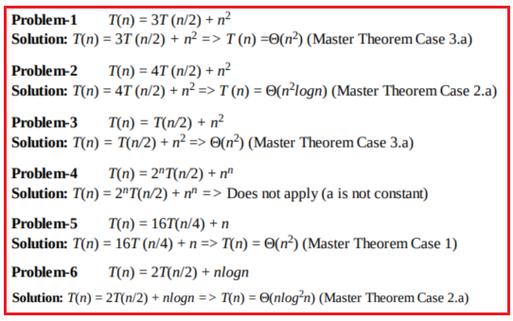
Problems on Master's theorem

Slide 44
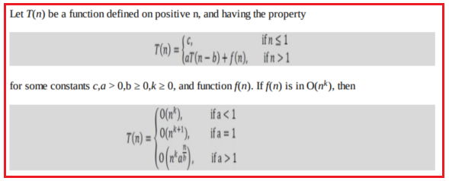
Master Theorem for Subtract and Conquer Recurrences

Slide 45
The variant of Subtraction and Conquer Master Theorem
The solution to the equation T(n) = T(α n) + T((1 – α)n) + βn, where 0 < α < 1 and β > 0 are constants, is O(nlogn).
Note:

Slide 46
Space Complexity
Algo(A,1,n)
{
int i;
for (i = 1 to n)
A[i] = 0;
}
Space complexity = O(1)
Extra space required to run the algorithm is i
Algo(A,1,n)
{
int i,j;
for (i = 1 to n)
A[i] = 0;
}
Space complexity = O(1)
Extra space required to run the algorithm is i,j

Slide 47
Example on Space Complexity
Algo(A,1,n)
{
int i;
create B[n];
for (i = 1 to n)
B[i] = A[i];
}
Space complexity = O(n)
Extra space required to run the algorithm is 1+n
Algo(A,1,n)
{
int i, j;
create B[n,n];
for (i = 1 to n)
for (j = 1 to n)
B[i,j] = A[i];
}
Space complexity = O(n²)
Extra space required to run the algorithm is 2+n²

Slide 48
Tree method for space complexity
A(3)
A(2) P(3)
A(1) P(2)
A(0) P(1)
For input size n, we need size of stack n+1 is required as ther are n+1 recursive calls. Let each call takes k memory cells, then total space required is (n+1)k = O(n)
A(n)
{
if(n≥1)
{
A(n-1)
printf(n)
}
}

Slide 49
Algorithm Design Techniques
Selecting a proper design technique for algorithms is a complex but important task. Following are some of the main algorithm design techniques:
1. Brute-force or exhaustive search
2. Divide and Conquer
3. Greedy Algorithms
4. Dynamic Programming
5. Branch and Bound Algorithm
6. Randomized Algorithm
7. Backtracking

Slide 50
Divide and Conquer Technique

Slide 51
Example for Divide and Conquer design
1. Binary Search
2. Merge Sort
3. Quick Sort
Binary Search: T(n) = T(n/2)+1
Quicksort:
T(n) = 2T(n/2)+n (In best case)
T(n) = n+T(n-1) (In worst case)
Merge Sort:
T(n) = 2T(n/2)+ O(n)

Slide 52
Mergesort

Slide 53
Divide and Conquer Step

Slide 54
Divide and Conquer Architecture

Slide 55
Merge Sort-Algorithm

Slide 56
Merge() function

Slide 57
Merge() Illustration

Slide 58
Contd...

Slide 59
Merge Sort: Function Calls Recursive function calls for six elements 9,6,5,0,8,2
ms(1,6)¹
ms(1,3)² ms(4,6)⁹ m(1,3,6)¹⁶
ms(1,2)³ ms(3,3)⁷ m(1,2,3)⁸ ms(4,5)¹⁰ ms(6,6)¹⁴ m(4,5,6)¹⁵
ms(1,1)⁴ ms(2,2)⁵ m(1,1,2)⁶ ms(4,4)¹¹ ms(5,5)¹² m(4,4,5)¹³
Numbers superscript to function calls
are used for stack representation
and order of execution in
space complexity side

Slide 60
Mergesort: Sort 9,6,5,0,8,2
index
1
2
3
4
5
6
9
6
5
0
8
2
Given unsorted array
6,9
0,8
5, 6,9
0,2,8
0,2,5,6,8,9
Sorted array

Slide 61
MergeSort: Recursion Tree method
Suppose n = 16
then the tree has 5 levels
i.e 16, 8, 4, 2, 1
Therefore height of tree is:
(log₂n+1)
At each level merging time is cn
Therefore: Total time complexity =
cn(log₂n+1) = θ(nlogn)

Slide 62
Merge Sort: Master's Theorem
T(n) = 2T(n/2)+ O(n)
by Master's theorem
implies T(n) = θ(nlogn)
T(n)
T(n/2)
T(n/2)
O(n)

Slide 63
MergeSort: Space Complexity
4
3
2
1
5, 6, 11, 12, 13
7, 8, 10, 14, 15
9, 16
All the functions which are in the same level going to occupy
the same cell. As n increases, levels are required.
No. of cells of stack is
Assume each cell takes a constant amount of space k
Size of stack =
Space required for stack = O(logn)
Space required for merging = O(n)
Total Space complexity = O(n+logn) = O(n)
Stack
Note: This algorithm falls under the category of “Out of place” Algorithm

Slide 64
QuickSort

Slide 65
Recursive algorithm for QuickSort

Slide 67
Illustration of Partition()

Slide 68
Quick Sort: Time Complexity
Note: partition() takes O(n) time as j moves entire list once.
In best case, position of pivot element divides array into half.
T(n) = 2T(n/2)+O(n)
T(n) = θ(nlogn)
In worst case, position of pivot element leaves n-1 elements otherside.
T(n) = T(0)+T(n-1)+O(n)
i.e T(n) = T(n-1)+cn
by back substitution
T(n) = T(n-3)+c(n-2)+c(n-1)+cn
T(n) = c+c.2+c.3+.....+cn
T(n) = O(n²)

Slide 69
Function Calls: Quick Sort
A: 5, 7, 6, 1, 3, 2, 4
Index: 1, 2, 3, 4, 5, 6, 7
QS(1,7)
P(1,7) QS(1,3) QS(5,7)
P(1,3) QS(1,1) QS(3,3) P(5,7) QS(5,4) QS(6,7)
P(6,7) QS(6,6) QS(8,7)
After 1st iteration
A: 1, 3, 2, 4, 7, 6, 5
Index: 1, 2, 3, 4, 5, 6, 7
×
×
×
Here element 4 which is the last element
considered as pivot, will go to its correct position.
×
×

Slide 70
Quick Sort: Space Complexity
No. of levels = No. of stack entities required.
In the previous slide, there are four levels are there. There are logn levels possible as per the left side picture.
Therefore:
Space Complexity(Average case) = O(logn)
n
n/2
n/2
n/4
n/4
n/4
n/4

Slide 71
Quick Sort: Space Complexity
No. of levels = No. of stack entities required.
There are n levels possible as per the left side picture.
Therefore:
Space Complexity(Worst case) = cn = O(n)
where c indicates every stack element is going to take c space
n
1
n-2
1
n-4

Slide 72
References
https://dotnettutorials.net/lesson/master-theorem/
Trevisan, L. W4231: Analysis of Algorithms. Retrieved May 31, 2016, from http://people.eecs.berkeley.edu/~luca/w4231/fall99/slides/l3.pdf

Slide 73
Thank You

